Slide 1



mCaffiene B2G2 Insights
View in Power BI
Last data refresh:
8/16/2023 5:59:45 AM UTC
Downloaded at:
12/9/2023 8:31:04 AM UTC

Slide 2
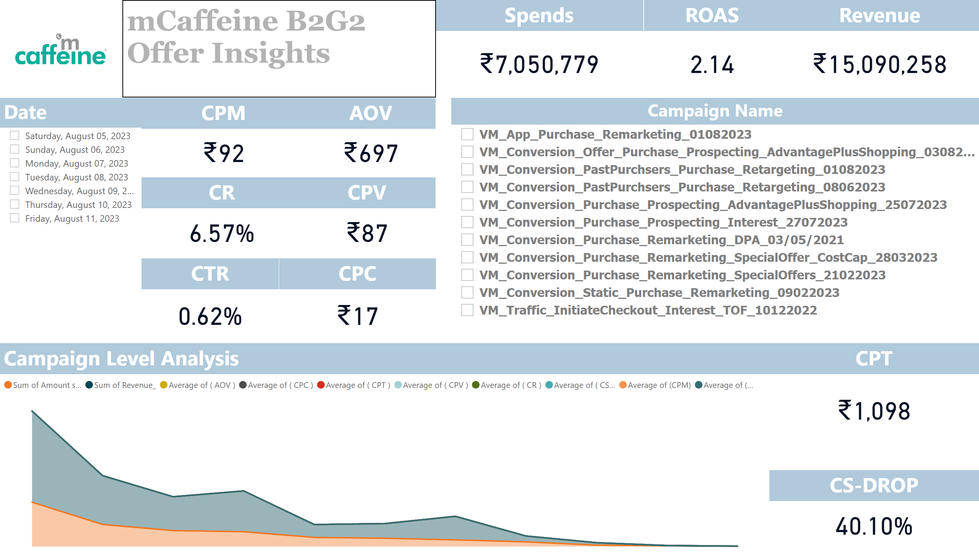
Page 1
Notes:
image
No alt text provided
textbox
No alt text provided
CS-DROP
No alt text provided
CTR
No alt text provided
CR
No alt text provided
ROAS
No alt text provided
CPT
No alt text provided
CPC
No alt text provided
CPM
No alt text provided
Revenue
No alt text provided
Spends
No alt text provided
Campaign Name
No alt text provided
Campaign Level Analysis
No alt text provided
CPV
No alt text provided
AOV
No alt text provided
Date
No alt text provided

